Slide 1
BYOD and other Trends
No, not BYOB!!

Slide 2
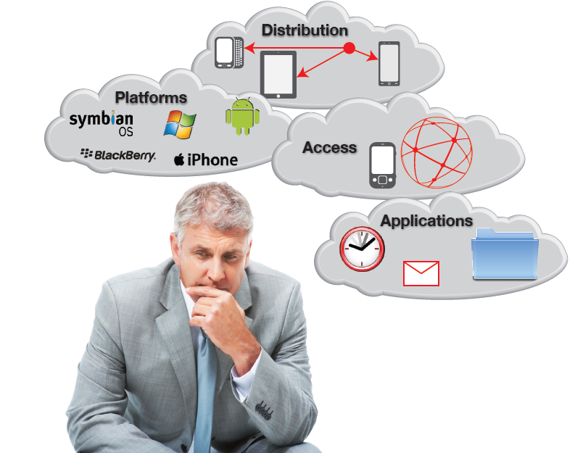
What is BYOD?
http://i.dell.com/sites/doccontent/business/smb/sb360/en/Documents/good-byod-best-practices-guide.pdf

Slide 3
BYOD
BYOD is the practice of allowing the employees of an organization to use their own computers, smartphones, or other devices for work purposes.
Bring Your Own Device (BYOD) , along with Bring Your Own Technology (BYOT), Bring Your Own Phone (BYOP) and Bring Your Own PC (BYOPC) initiatives within organizations have evolved to empower workforces, through the ‘CONSUMERIZATION of IT'.
The GOAL of BYOD is to increase productivity and reduce costs
The driving force behind BYOD is IT self-sufficiency among company employees

Slide 4
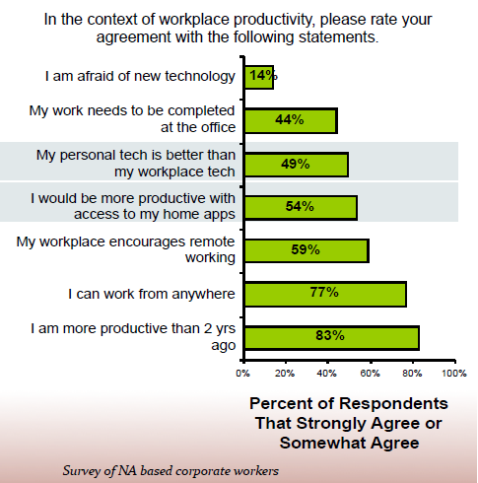
Consumerization
On avg. workers
use 3 consumer
tools in their work
  landline phone
  cell phone
  laptop or desktop

Slide 5
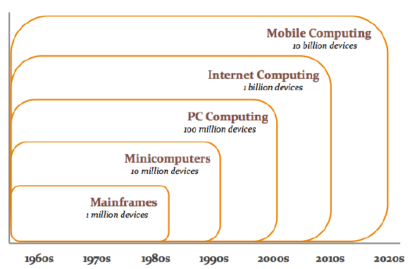
The Size of the Problem

Slide 6
Birth of the BYOD ERA
Mainframe and minicomputing eventually gave way to the client-server driven PC computing era.
In the 1990s, PC computing was supplanted as the dominant computing model with Internet computing.
Today the industry finds itself in the midst of the most significant transition ever — the shift to mobile computing
BYOD has been the primary driver for mobile computing
BYOD thus puts us on the verge of being able to deliver on the Holy Grail for IT (anybody know what that is?)
  Delivering any content or application to any device, no matter where the worker may be.

Slide 7
Impacts of BYOD
BYOD can raise number of devices per user from 3 in 2012 to an estimated 7 devices by 2016!
  This means that, even with no employee growth, IT managers have to deal with 300 percent more devices now and plan for 700 percent growth!
Majority of consumer devices are wireless only
Easy to use real-time video conferencing can create unpredictable, heavy traffic flows

Slide 8
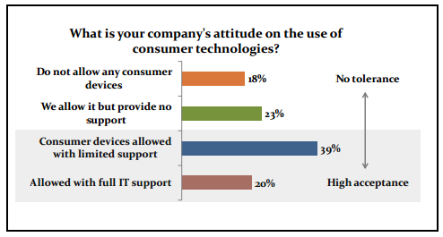
Companies are tolerant to consumer technologies
High performance wireless is a must-have technology
But.. Bandwidth demand is exploding …and..
Workers are portable and demand mobility

Slide 9
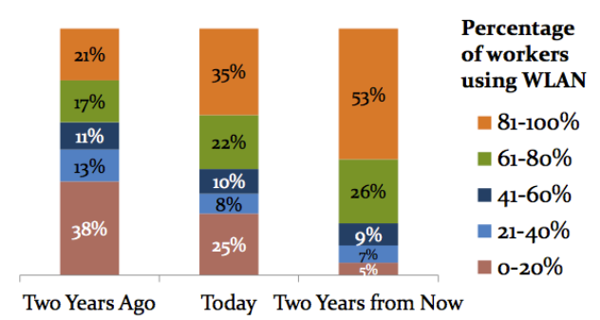
Leading to Challenges to the Network

Slide 10
Two BYOD Issues for the Enterprise
Management
  Who
    Will be able to connect (employees, what level)
  What
    Will be available (data, services, applications)
    Processes will be in place (support, deploy, financial)
    Policy (governance)
Technical
  Which
    Devices will be supported
    Data will be available
  When
  Where
  and finally ….How

Slide 11
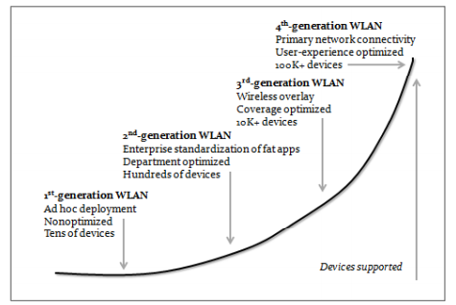
Wireless LAN evolution
Wireless LAN connectivity is now the norm
  Current-generation WLANs are shared mediums
  They have inconsistent and poor user experience along with
  High TCO
a fourth-generation wireless LAN technology is needed to usher in the BYOD-led mobile computing era
User experience must be at the heart of next-generation WLAN, and technology must provide a consistent, predictable, and secure experience for any device or application

Slide 12
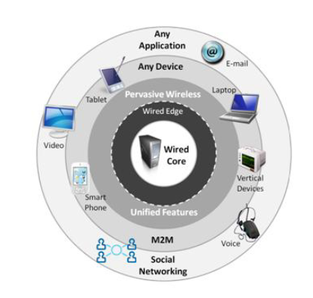
Wireless evolution
BYOD, mobile computing and media-rich applications put significant strain on wireless networks.
Creating a highly predictable, highly resilient experience requires an understanding of more than just coverage.

Slide 13
Some must have requirements for the next generation WLAN
Ability to handle real-time traffic at scale (heavy loads)
Lower TCO than legacy technology
Centralized control and manageability
Can handle a highly dense environment
Ability to add capacity or coverage easily
Integrated security (encryption+ access control+ guest services)
Easy migration to 802.11ac

Slide 14
Example Considerations for BYOD for the Enterprise
General Technical
Financial reimbursement
Technical support
Liability

Slide 15
General Technical
What devices and mobile OS will we support?
What are the security requirements: devices, applications, data access?
What risks are introduced by employee access from their own devices?
What is our tolerance to those risks?
How can BYOD be managed to reduce the risk to sensitive data or intrusion on employee rights to their own devices?

Slide 16
Financial Reimbursement
Direct Billing: The organization buys the device, pays for its data plan, and all charges are billed directly.
Stipend: The organization offers a monthly stipend to support the employee’s use of the device, typically added to a paycheck.
Expense: The organization does not purchase phones or data plans, but each department manager can approve or reject a certain amount of employee spending on these items, reimbursing the employee based on expense reports.

Slide 17
Financial Reimbursement Questions to consider
What are the financial considerations for our BYOD policy?
Is reimbursement available? If so, for which services (voice, data, WiFi hotspots) and under what conditions (business vs. personal usage, manager approval)?
Are any services not eligible for reimbursement (SMS/MMS, ringtones, 411 calls, or others)?
Are there caps on reimbursements (fixed monthly stipend or maximum expense-back limits, irrespective of charges incurred)?
Are users eligible for full or partial reimbursement of device acquisition or replacement costs?
Which department pays for services extended to employees on mobile devices?
If an employee is provided with a smartphone for after-hours calls, does he receive overtime pay/additional stipends for taking those calls?

Slide 18
General Technical Qs
Do we have cross-platform (iOS, Windows Mobile, and Android) knowledge, tools, and apps?
How will we distribute applications to and manage applications on employee devices?
How will we develop secure applications for mobile devices?
What applications should we deploy—email, time and expense management, corporate directories, CRM?
Will we provide intranet access to BYOD users?
What types of users will be provided with BYOD devices? Will we provide them to everyone, or a select group that has a greater need for mobility?
What levels of access to applications and services will be afforded to each group of users?

Slide 19
Technical Support
What levels of support will we provide?
Are all employees eligible for mobile access to company data and applications?
Will we restrict access based on role, title, manager approval, geographic, or other organizational considerations?
Will we restrict access to particular company applications or data? If so, which apps and data?
Will we support all devices?
What level of support will we provide for personally owned devices?
Will we support only corporate data or apps?
Should we support custom apps on personally owned devices?

Slide 20
Managing Risk
What are the risks for loss of corporate data or intellectual property?
How is corporate content on employee devices managed without interfering with personal use?
Must users sign an acceptable use policy before connecting personal devices to the corporate network?
Is it legally acceptable to wipe corporate or personal data if the policy is violated and data is at risk of compromise?
How much data, such as GPS data, should we collect about users?
How should we handle lost or stolen devices?
What should happen if a user violates policy?
Notes:
What are the risks for loss of corporate data or intellectual property?
• How is corporate content on employee devices managed without interfering with personal use?
• Must users sign an acceptable use policy before connecting personal devices to the corporate network? Monitor Whole Device Password Acceptable Use Policy Policy
• Is it legally acceptable to wipe corporate or personal data if the policy is violated and data is at risk of compromise?
• How much data, such as GPS data, should we collect about users?
• How should we handle lost or stolen devices?
• Will our organization enforce the use of a “whole device” password?
• Should and can we prevent jailbroken or rooted devices from accessing corporate data and apps?
• What is our policy regarding use of devices by users other than the corporate end user?
• What should happen if a user violates policy?
• Should different violations be treated differently? (e.g., eligibility vs. security vs. acceptable use)?

Slide 21
Governance
Get Executive Buy-in
Don’t wait to be asked (this helps to have one policy and reduces the changes of rogue department deployments)
Involve other departments (HR, Purchasing, Audit/Compliance, Legal)
Decide who is eligible
Negotiate with carriers
Decide what will be supported

Slide 22
Mobile Device Management
Enforce device-level access controls
Require PIN
Request full device wipe remotely
Encrypting data at rest
Report on wiped devices (including location)

Slide 23
Another Approach?
Evolution from “straight-jacket” approach
Control of the data at the source (using a tiered approach and DRM)
  Control who can access at source
  Enable basic usage rights (preview, change, copy, assigning rights)
  Enforce access rights (password access, policy access)

Slide 24
Top 10 BYOD Pitfalls
Not communicating with employees – Without open communication with employees, no BYOD program can be successful. A BYOD rollout should flow downhill. Executives should enroll their devices first, communicating the capabilities and privacy features before deploying throughout the organization.
Not enforcing passcodes on devices – Today’s BYOD devices house all sorts of sensitive corporate data. Documents, emails and more are all susceptible to being lost or stolen if the simple step of setting a password is not taken.
Not protecting ActiveSync – Most mobile devices on the market today have ActiveSync enabled. There are certainly benefits to the service. With an Enterprise Mobility Management (EMM) solution, administrators are enabled to manage devices in the cloud, auto-quarantine devices and approve or block devices in the cloud.
Not managing email profiles – Often, email profiles remain active after an employee leaves a company, exposing sensitive data. To protect the organization, administrators are forced to completely wiping devices. However, with an EMM solution, administrators can configure and manage profiles, and selectively remove the profile from a profile device, without touching the other information on the phone.
Not enforcing encryption – Even with a passcode enabled on a device, intruders can still get in. Encryption exists to protect data, but unfortunately many companies do not take advantage of it. There are various encryption options for IT administrators to consider, whether it’s the whole device or just a corporate container. (One of my favorite personal ones is Truecrypt- alas- no longer updated; but you can still use it!)
http://www.idgconnect.com/blog-abstract/8793/top-byod-pitfalls

Slide 25
Top 10 BYOD Pitfalls
Not providing education/training to end users – Organizations today are sensitive to users that do not choose to enroll in EMM for privacy reasons. (EMM solutions provide organizations valuable info on what apps are downloaded etc) The goal is to communicate openly with employees and let them know what is being tracked and to allow them to opt out if desired.
Not setting minimum requirements on OS versions – With new OS, employees are sometimes behind the curve when it comes to downloading the latest version for their BYOD devices. This is bad news for employers, because older versions may have vulnerable apps or information, Organizations need to be able to monitor and enforce updates.
Using the same ID for everyone – Organizations need to enforce separate IDs for each user, and should push apps to individual IDs. (eg. same Skype or Apple Id)
Not restricting corporate data flow – Employees often use data sharing apps like Dropbox in the majority of organizations. Even if the app is managed, employees are still able to transfer internal information. The goal is to integrate fully with a container based approach where content is directly pushed to a container app on the device that can be controlled by restrictive policies. That way, corporate content can be removed on-demand from these devices without having to worry about data leak.
Not doing due diligence when considering BYOD – Many organizations don’t take the critical step of figuring out why they need BYOD before they implement it, and don’t consider how employing a management solution will affect the current state of things.
http://www.idgconnect.com/blog-abstract/8793/top-byod-pitfalls

Slide 26
A subject we missed
Network/Enterprise/Data Security
2013 Data Breach Investigations Report, ©Verizon
http://www.verizonenterprise.com/DBIR/2013/

Slide 27
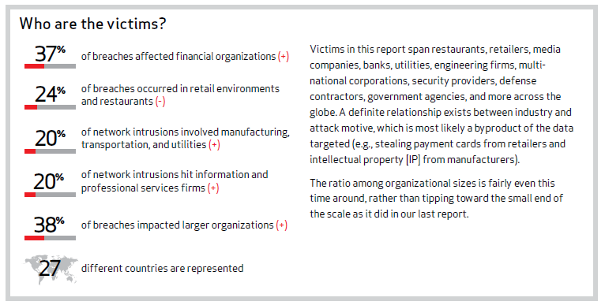
Victims of Security Breaches
2013 Data Breach Investigations Report, ©Verizon

Slide 28
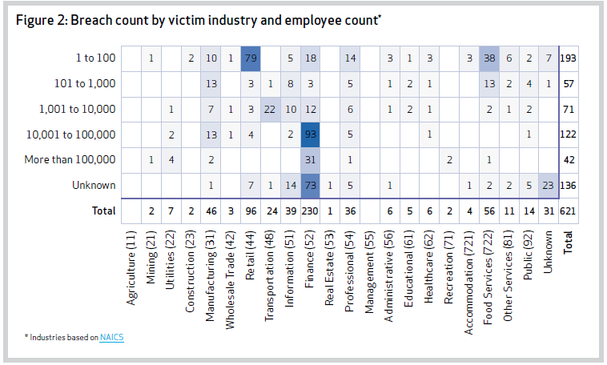
How bad is it?

Slide 29
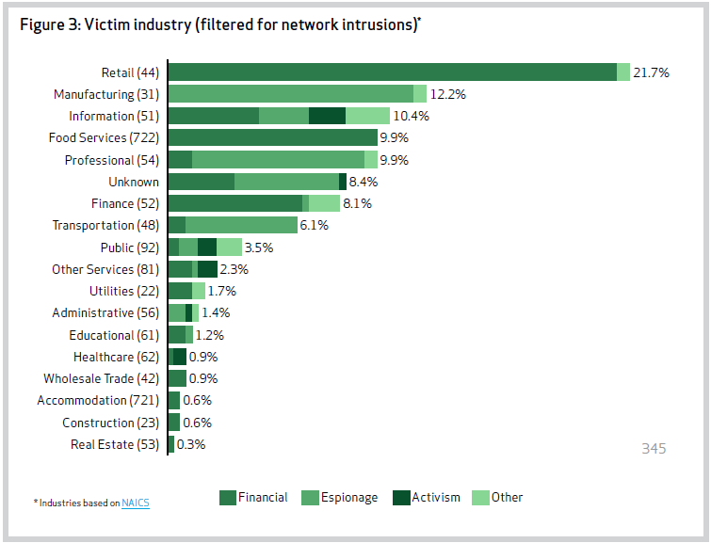
Industry Numbers

Slide 30
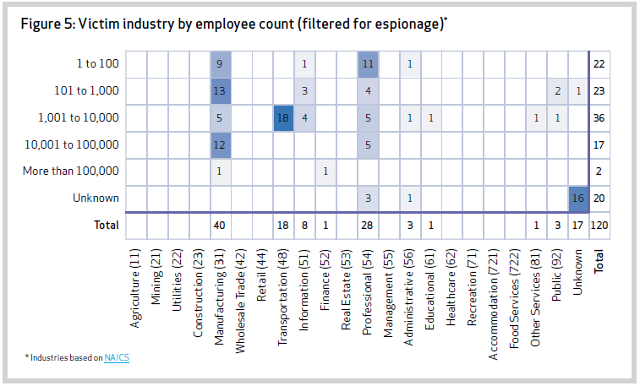
Worse for the Little Guys?

Slide 31
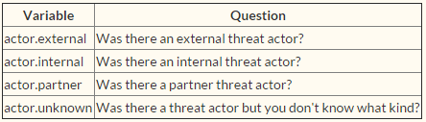
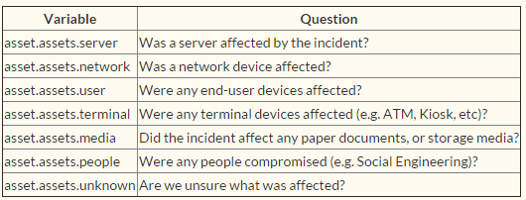
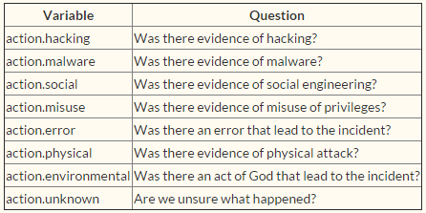
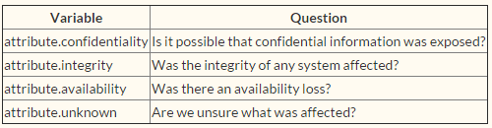
What was Affected
The Vocabulary for Event Recording and Incident Sharing (VERIS) is a tool to help an organization collect incident data in a consistent way to support decision making.
Actors: Whose actions affected the asset?
Actions: What actions affected the asset?
Assets: Which assets were affected?
Attributes: How the asset was affected?

Slide 32
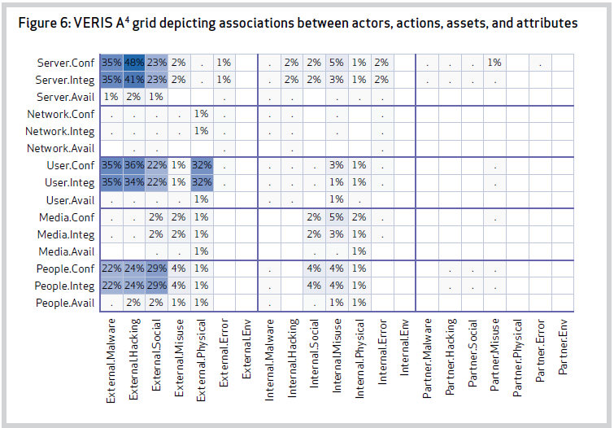
What was Affected

Slide 33
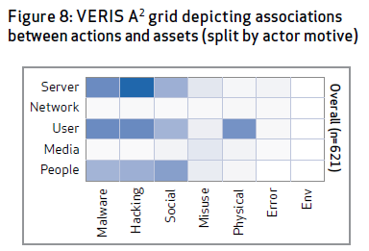
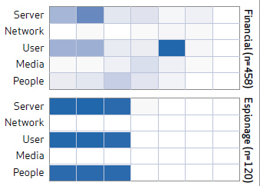
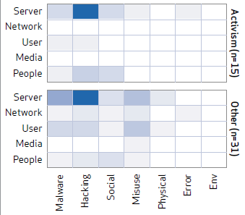

Doing what to what?

Slide 34
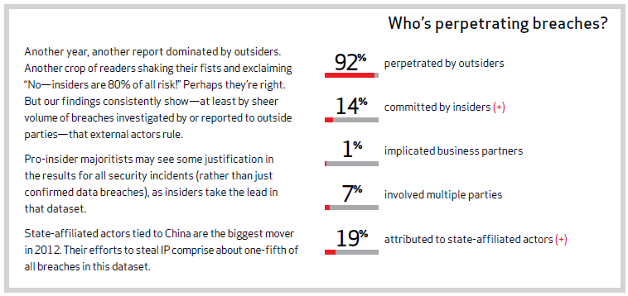
Who are the Bad guys?

Slide 35
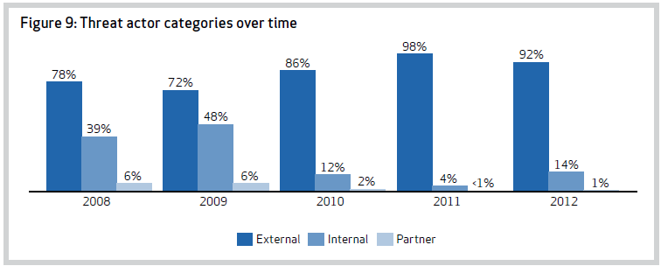
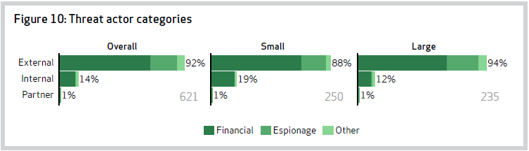
Actor Categories

Slide 36
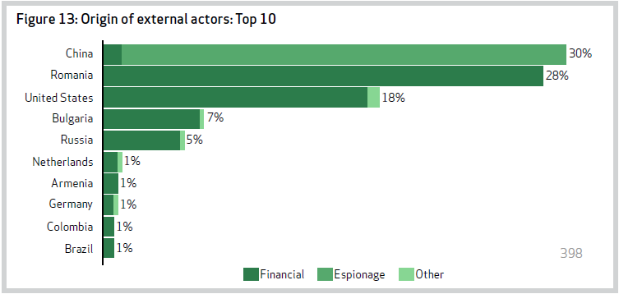
External Actor Location

Slide 37
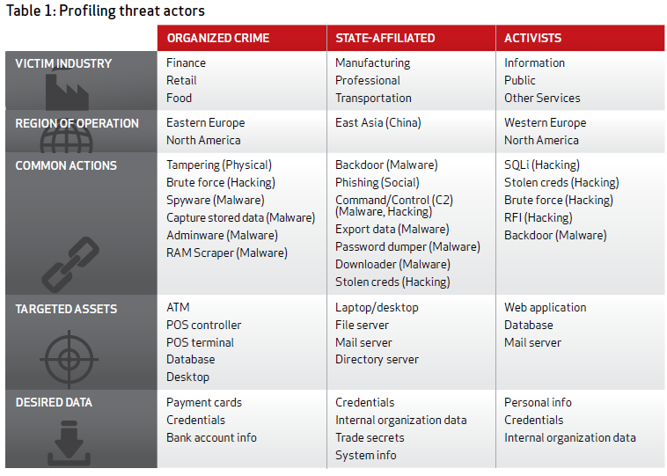
Threat Actor Profiles

Slide 38
Insider Threat Indicators
Bragging about the damage they could do
Utilizing resources for a side business, or serious conversations with coworkers about starting a side business
Social engineering
Unusual activities (pattern or quantity of information accessed)
Former employees with access

Slide 39
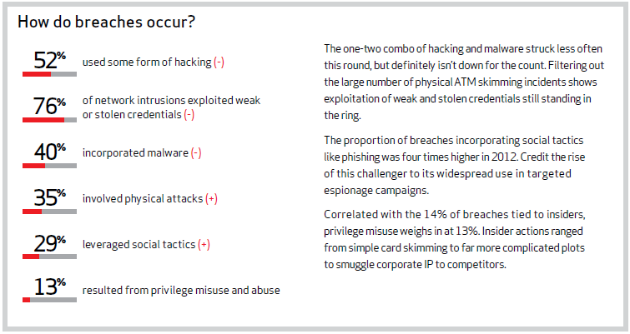
How does it happen?

Slide 40
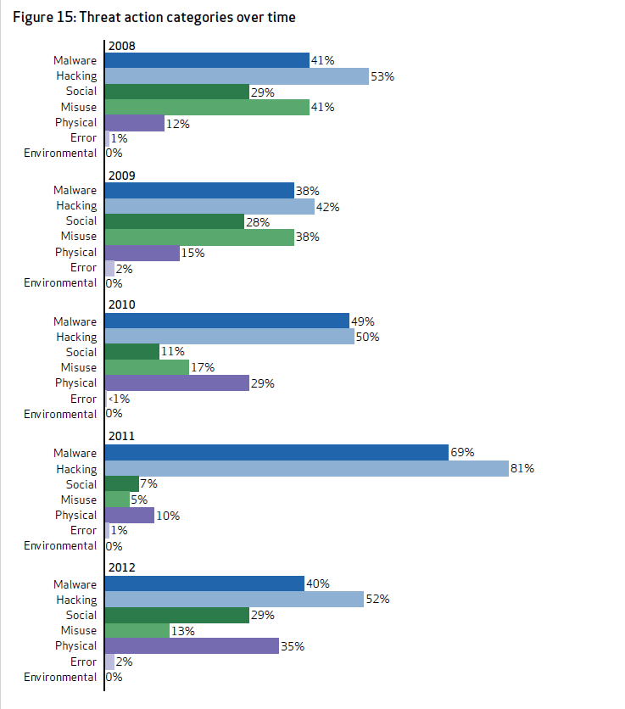
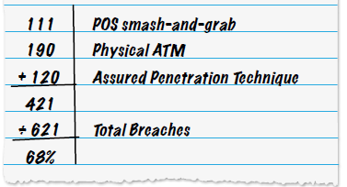
Actions
POS (point of sale)– brute force/malware
Skimming devices on ATM
APT (assured penetration technique)– phishing-malware-
hacking

Slide 41
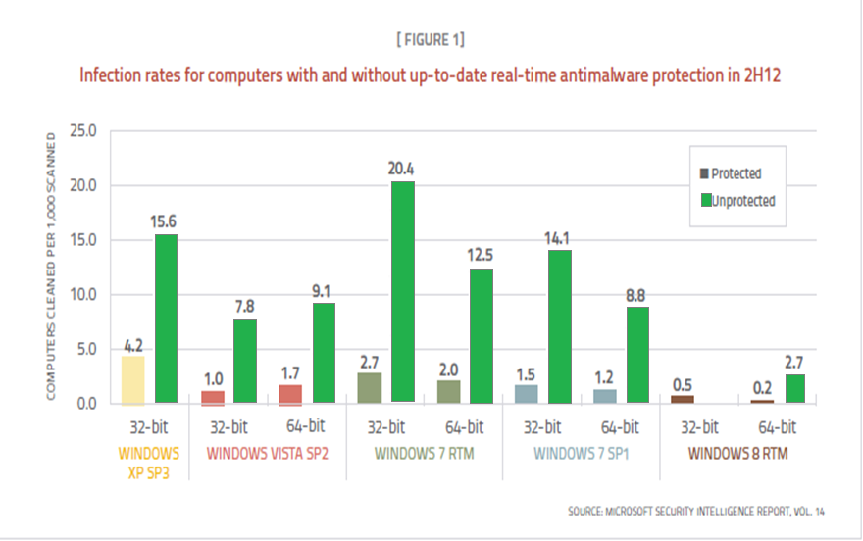
Malware Infections – is MS really bad?

Slide 42
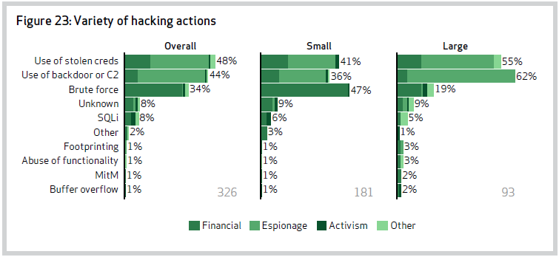
Hacking Types by Motivation

Slide 43
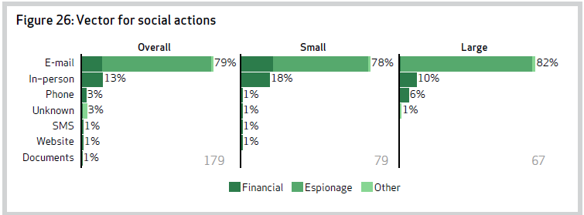
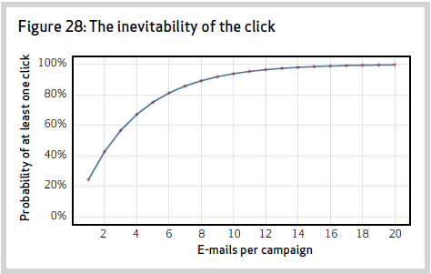
Social Action Threats

Slide 44
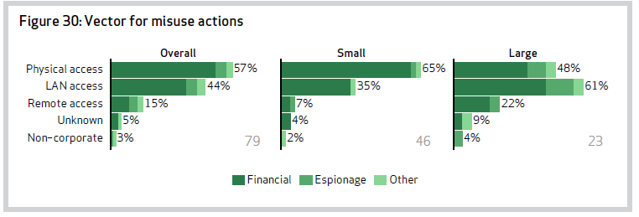
Misuse Actions
Note that working from home doesn’t increase the risk!

Slide 45
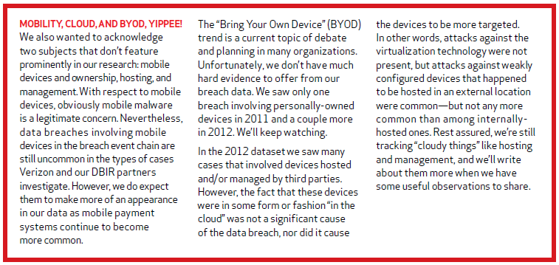
Mobile, BYOD not so bad

Slide 46
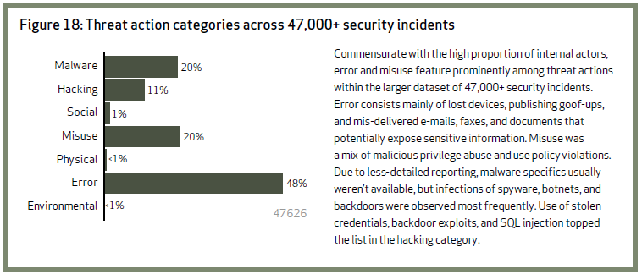
Bigger Pic

Slide 47
Ransomware
Access (often through RDP), disable functional backup, encrypt the data, demand ransom ($$s) for the decrypt key
Ransomware spreads through e-mail attachments, infected programs and compromised websites.
  After a victim discovers he cannot open a file, he receives an email ransom note demanding a relatively small amount of money in exchange for a private key. The attacker warns that if the ransom is not paid by a certain date, the private key will be destroyed and the data will be lost forever.
  The victim is duped into believing he is the subject of an police inquiry. After being informed that unlicensed software or illegal web content has been found on his computer, the victim is given instructions for how to pay an electronic fine.
  The malware surreptitiously encrypts the victim's data but does nothing else. In this approach, the data kidnapper anticipates that the victim will look on the Internet for how to fix the problem and makes money by selling anti-ransomware software on legitimate websites.

Slide 48
And .. Some REALLY NASTY Malware
(an Example )
From: FBI New York [mailto:jw@hnart.or.kr]
> Sent: Thursday, May 28, 2015 10:46 AM
> Subject: YOUR FRIEND HAS PAID US TO KILL YOU BY ALL MEANS
>
> Attention:
>
> I felt very sorry and bad for you, that your life is going to end like this if you don't comply, i was paid to eliminate you and I have to do it within10 days.Someone you call your friend wants you dead by all means, and the person have spent a lot of money on this, the person also came to us and told us that he wants you dead and he provided us your names, photograph and other necessary information we needed about you. If you are in doubt with this I will send you to death.
>
> Meanwhile, I have sent my boys to track you down and they have carried out the necessary investigation needed for the operation, but I ordered them to stop for a while and not to strike immediately because I just felt something good and sympathetic about you. I decided to contact you first and know why somebody will want you dead by all means. Right now my men are monitoring you, their eyes are on you, and even the place you think is safer for you to hide might not be. Now do you want to LIVE OR DIE? It is up to you. Get back to me now if you are ready to enter deal with me, I mean life trade, who knows, and I might just spear your life, $9,000 usd is all you need to spend. You will first of all pay $3,000 usd then I will send the tape of the person that want you dead to you and when the tape gets to you, you will pay the remaining $6,000 usd. If you are not ready for my help, then I will have no choice but to carry on the assignment after all I have already being paid before now.
>
> Warning: do not think of contacting the police or even tell anyone because I will extend it to any member of your family since you are aware that somebody want you dead, and the person knows all members of your family as well. For your own good I will advise you not to go out once is 7pm until I make out time to see you and give you the tape of my discussion with the person who want you dead then you can use it to take any legal action.
>
> Good luck as I await your urgent respond.
>
> Reply with this mail wwups@live.com
>
> contact Mr. Jacks H. Killer with below information
>
> Email wwups@live.com
>
> Thanks,
> Mr. Jacks H. Killer.
>

Slide 49
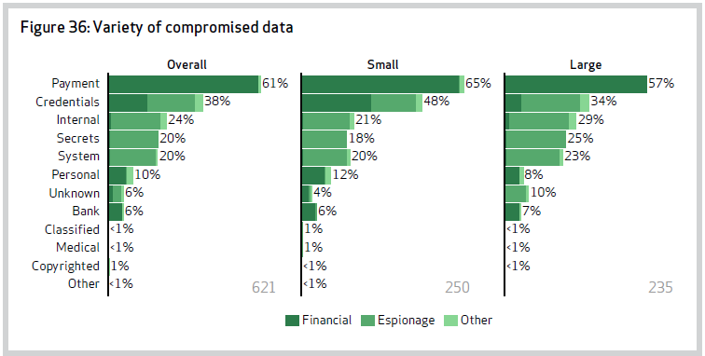
What was compromised?

Slide 50
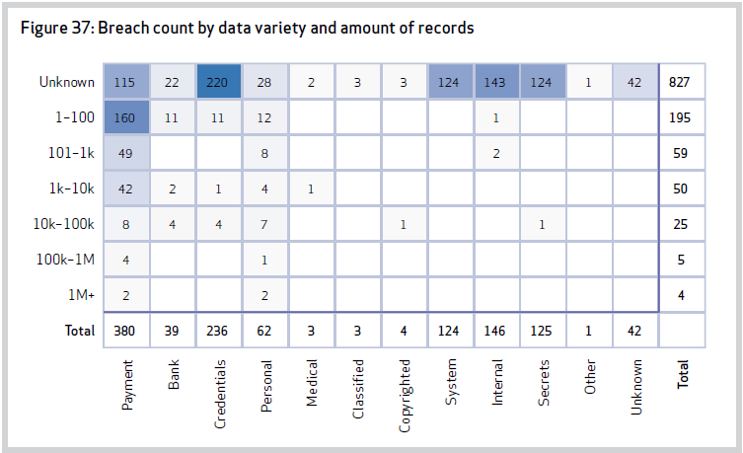
Where was the data?
Most was data at rest (2/3)
In process (1/3) (RAM, skimmers, keyloggers)

Slide 51
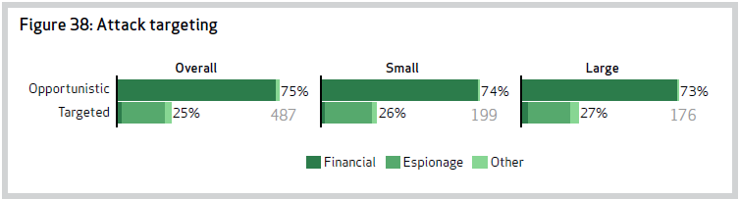
Targets?
Opportunistic – not specifically chosen, identified because they exhibited a weakness the attacker knew how to exploit
Targeted – specifically chosen, then weakness identified and exploited

Slide 52
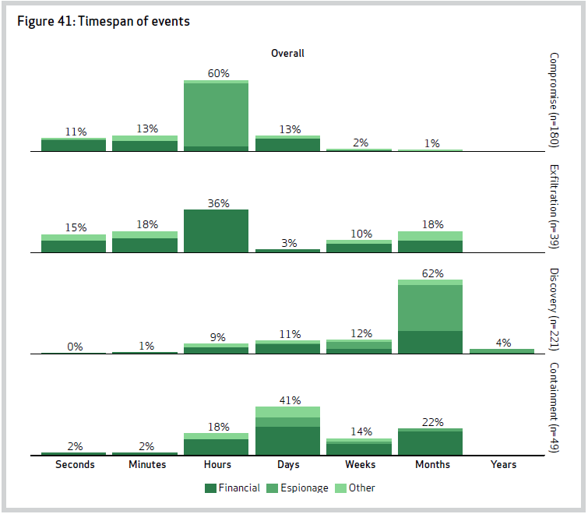
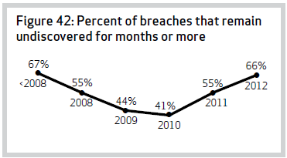
Time to Discovery

Slide 53
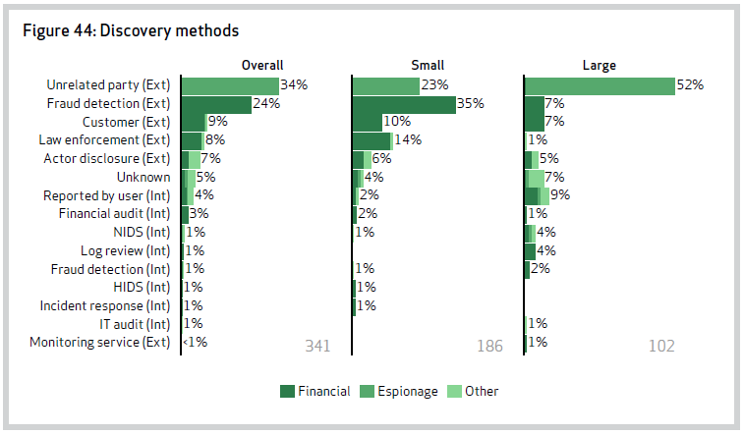
How discovery was made

Slide 54
20 Critical security controls
1. Inventory of Authorized and Unauthorized Devices: Asset tracking
2. Inventory of Authorized and Unauthorized Software: Software inventories, notifications regarding unapproved software.
3. Secure Configurations for Hardware and Software on Laptops, Workstations, and Servers
4. Continuous Vulnerability Assessment and Remediation: Automated vulnerability scanning, port checking, and patch management solutions
5. Malware Defenses: Anti-virus tools, disabling auto-run, traffic analysis, secure e-mail usage.
6. Application Software Security: Application testing and code review
7. Wireless Device Control: Wireless device identifiers, network access control
8. Data Recovery Capability
9. Security Skills Assessment and Appropriate Training to Fill Gaps: Security awareness training, security policies, and awareness testing
10. Secure Configurations for Network Devices such as Firewalls, Routers, and Switches: Strong authentication for network infrastructure

Slide 55
20 Critical security controls
11. Limitations and Control of Network Ports, Protocols, and Services
12. Controlled Use of Administrative Privileges: Identification and monitoring of administrative accounts, restriction of access to administrative accounts, and securing administrative accounts with strong authentication
13. Boundary Defense: Ingress (enter) and egress (exit) filtering based on blacklists, and default deny principle, DMZ traffic monitoring, IDS technologies.
14. Maintenance, Monitoring, and Analysis of Security Audit Logs
15. Controlled Access Based on the Need to Know: Network segmentation, logical access control
16. Account Monitoring and Control: Account auditing, password parameters, account lockout settings, monitoring attempts to access disabled accounts
17. Data Loss Prevention: Mobile hard drive encryption, DLP software
18. Incident Response and Management
19. Secure Network Engineering: Network segmentation, establishment of security zones
20. Penetration Tests and Red Team Exercises

Slide 56
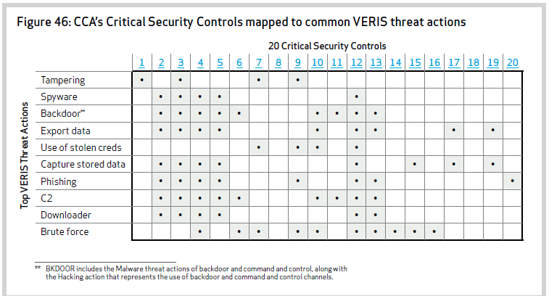
20 Critical security controls mapped to common VERIS threat actions
*CCA – Consortium for Cybersecurity Action

Slide 57
Cyber Kill Chain Approach
In military parlance, a “Kill Chain” is a phase-based model to describe the stages of an attack, which also helps inform ways to prevent such attacks. These stages are referred to as: Find, Fix, Track, Target, Engage, Assess
Similarly Cyber Kill chain model (Lockheed Martin) where the phases of a targeted attack are described.
Reconnaissance: look from the outside
Weaponization: Create tools to gain access (attempt to enter)
Delivery: Deliver the payload to target
Exploit: Exploit the weakness in defense
Installation: Install tools to allow attacker to operate
Command & Control: Communicate (phone home) for further commands
Actions: Take actions, such as exfiltrating data

Slide 58
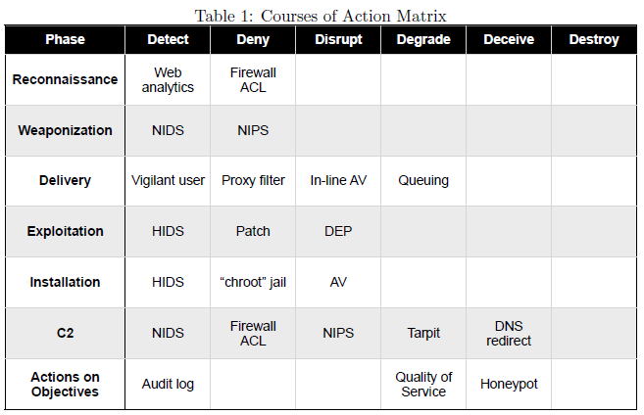
Courses of Action
NIDS- Network Intrusion Detection sys, HIDS- host intrusion, DEP = Data Execution Prevention,

Slide 59
It is not just about prevention
It is about early detection
It is about response
Make it more “expensive” for the attacker to be successful
  (the hope is they will find weaker subjects)
  Microsoft EMET (enhanced mitigation experience toolkit) – blocks entire classes of exploits -- free

Slide 60
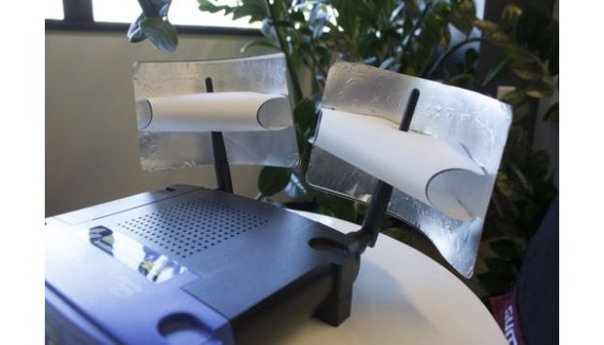
Yes, they actually work!

Slide 61
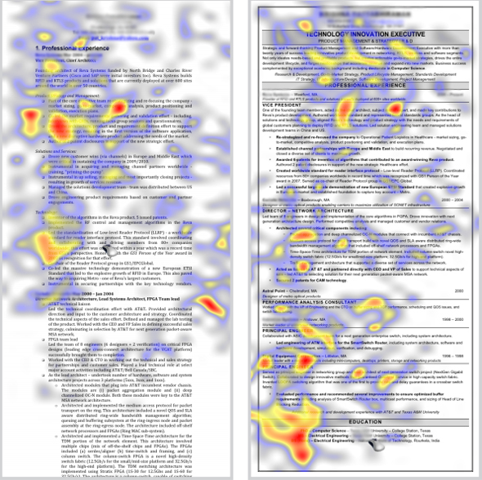
What Recruiters look at in 6 seconds

Slide 62
Class Wrap Up
  I have read some of your reflection essays! They were beautifully written! Thank you!!
I ask for further feedback on the course materials
  On the memos
  On the Web Assignments
Did we meet the objectives?
Did we meet YOUR goals?
Be sure to fill out DePaul University Survey. It is sincerely appreciated!
NEVER hesitate to reach out to me in the future via email, linkedin or otherwise. I would love to hear from you!

Slide 63
Final Exam
Due back : Sunday, 7/19/2015 before 11:30 pm Central Time
Don’t miss the deadline, I will not accept emailed responses!

Slide 64

This has been a very enjoyable class.
Keep in touch!

